Slide 1
FCB Unit IV
R G Brajesh

Slide 2
Cellular respiration

Slide 3
Cellular Respiration
How energy is produced in all living system?
  Most energy used thru conversion of ATP molecules into ADP molecules
  Thus cells must continually convert ADP molecules back into ATP molecules
  This process is known as respiration
There is a difference between breathing and respiration
  Breathing: physical process that involve exchange of gases from environment to cells.
  Cellular respiration: chemical process that releases energy from organic compounds (food), gradually converting it into energy that is stored in ATP molecules

Slide 4
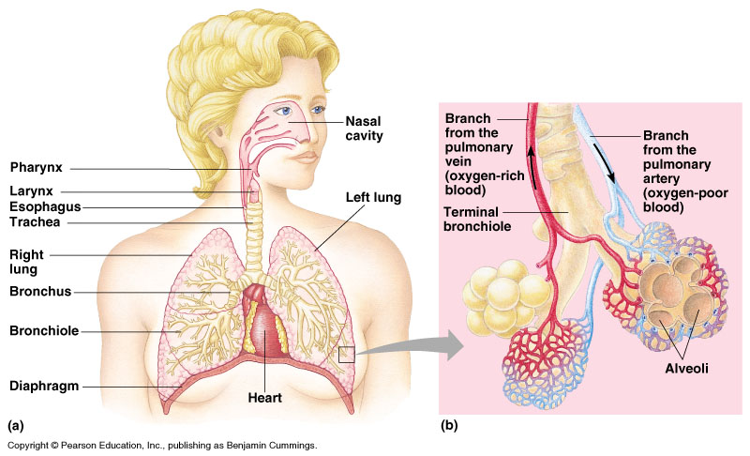
Breathing

Slide 5
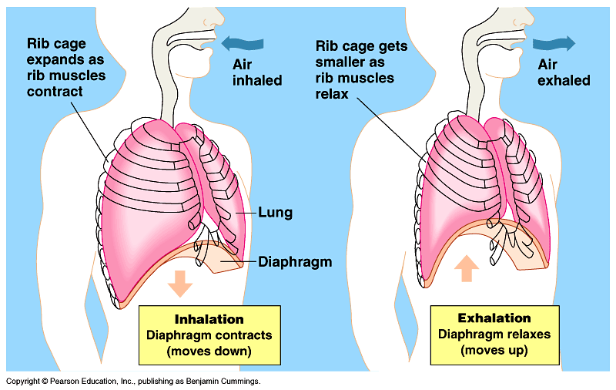
Gas exchange
Oxygen diffuses from alveoli→capillaries
It loosely bonds to hemoglobin, forming oxyhemoglobin
The oxygen separates from the blood in the body tissues
Carbon Dioxide and water diffuse from cells into capillaries
Carbon dioxide is carried in the form of bicarbonate ions (HCO3-)
In lungs, these wastes diffuse from the capillaries into alveoli

Slide 6
Disorders of the Respiratory System
Asthma: Allergic reaction where bronchial tubes narrow and make breathing difficult
Bronchitis: Inflammation of bronchial tube linings. Swelling causes air passages to become narrowed and mucus filled. Coughing and difficulty breathing is a result
Emphysema: Walls of the alveoli break down. This decreases surface area. Shortness of breath, difficulty in breathing, decreased lung capacity is a result

Slide 7
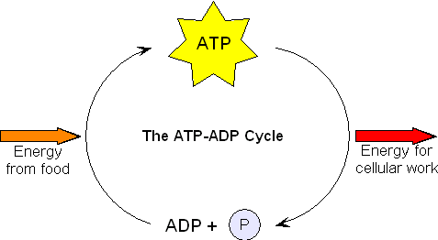
Cellular respiration
A series of enzyme-controlled reactions in which the chemical bond energy released by the breakdown of glucose is transferred to the bonds of ATP.
  This happens in the mitochondria for aerobic cellular respiration
  It happens in the cytoplasm for anaerobic cellular respiration

Slide 8
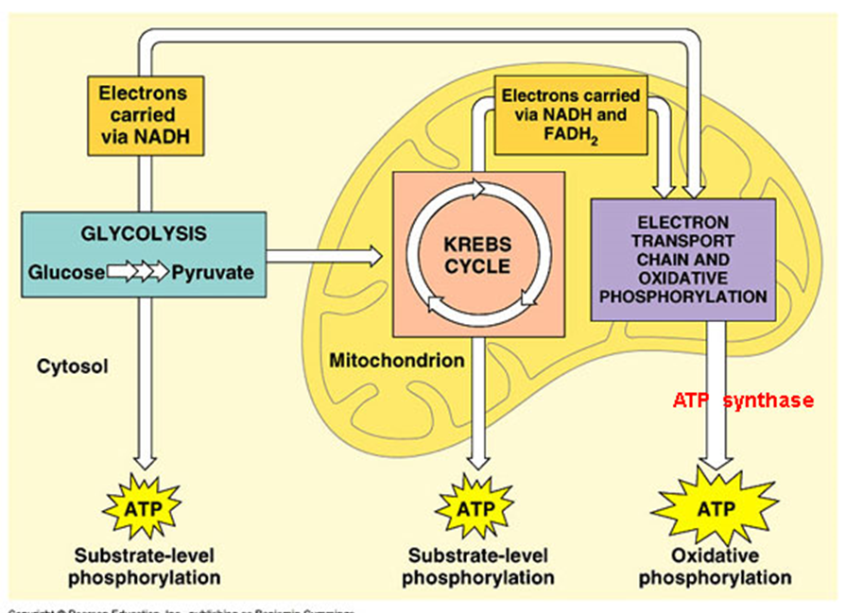
Cellular respiration
Three pathways:
  Glycolysis
  Krebs cycle
  ETC
glycolysis: releases only a small amount of energy (2 net ATP)
    If oxygen present, it will lead to two other pathways that release a lot of energy: Krebs cycle & Electron Transport Chain
    If oxygen absent glycolysis is followed by a different pathway: Alcoholic Fermentation or Lactic Acid Fermentation

Slide 9
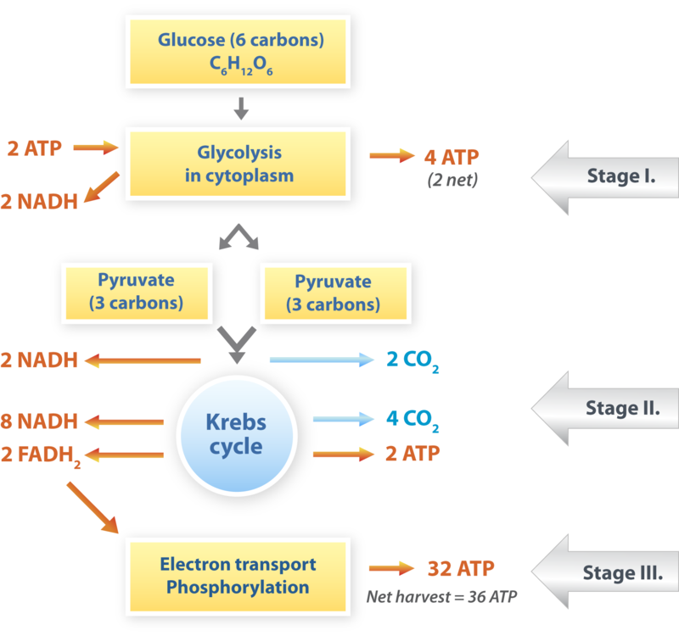
Respiration equation
All three combined make up Cellular Respiration: Glycolysis + Krebs Cycle + Electron Transport Chain
    Equation for cellular respiration:
    6O₂ + C₆H₁₂O₆ -------→ 6CO₂ + 6H₂O + energy (ATP)
    oxygen + glucose -----→ carbon dioxide + water + energy

Slide 10
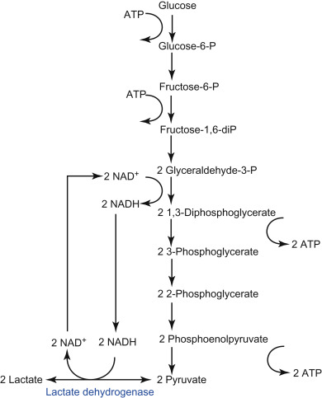
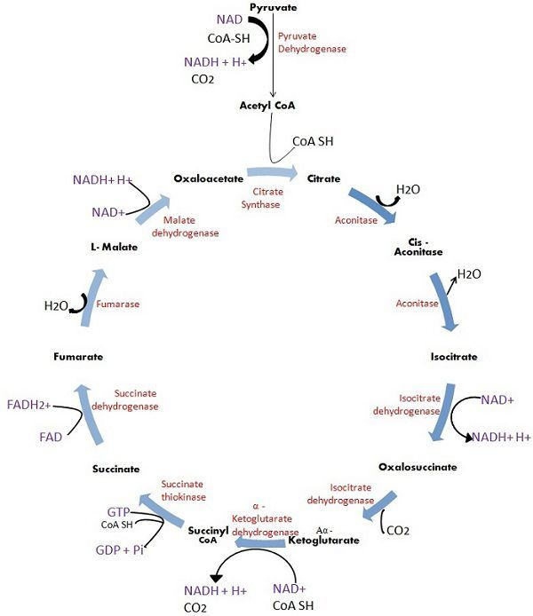
Pathway mechanism

Slide 11
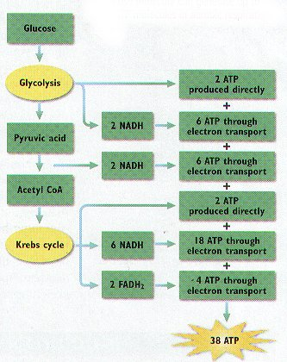
Total ATP Gain from 1 molecule of ATP

Slide 12
Blood/fluid circulation in humans

Slide 13
Ancient View
William Harvey’s 1628 modeling:
Brain
Cardiac output of 7.258 liters/day
Body tissue
vital spirits flow
‘Nutritive blood‘ flow
Heart
Air flow
Liver
Nutrition
Lungs
Stomach

Slide 14
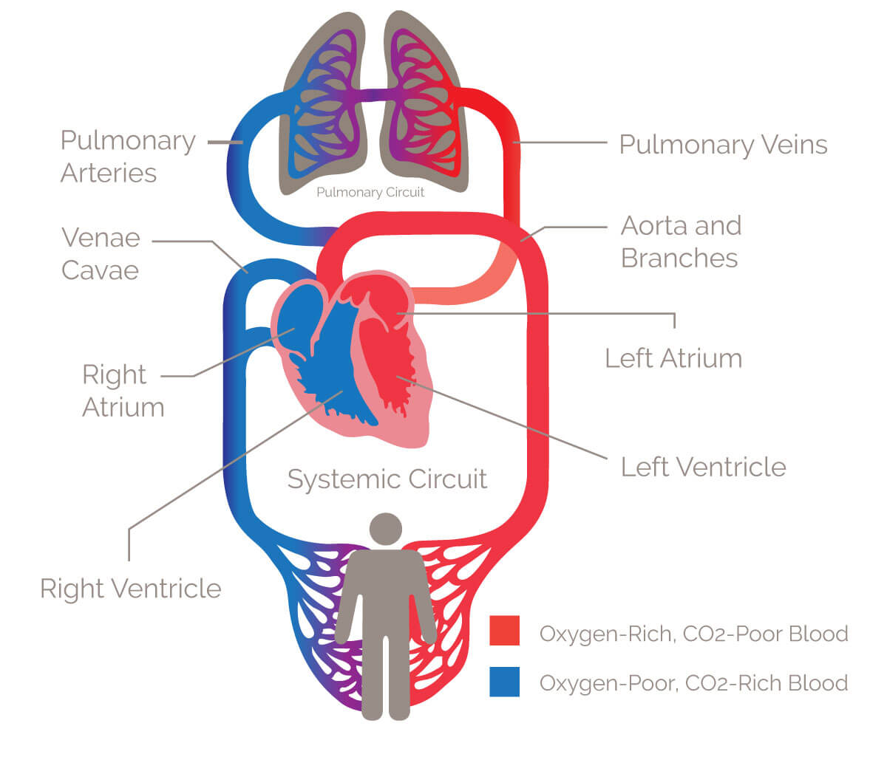
Current understanding

Slide 15
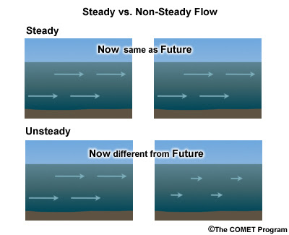
Flow properties
Types of flow
  Steady Flow- The flow in which the velocity of fluid is constant at any point is called as steady flow.
  Unsteady Flow-When the flow is unsteady , the fluid velocity differs between any two points.

Slide 16
Flow properties
Laminar and Turbulent Flow
  Laminar flow: all the particles proceed along smooth parallel paths and all particles on any path will follow it without deviation. Hence all particles have a velocity only in the direction of flow.
  Turbulent Flow: The particles move in an irregular manner through the flow field. Each particle has superimposed on its mean velocity fluctuating velocity components both transverse to and in the direction of the net flow.
Typical particles path
Particle paths

Slide 17
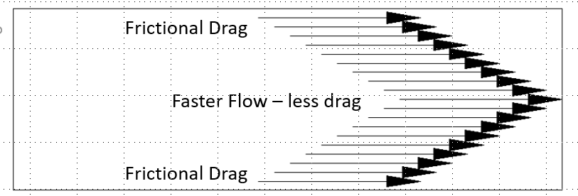
Flow properties
Newtonian fluid: A Newtonian fluid is a fluid that the viscosity stays the same when the shear rate changes. The viscosity will still change with a change in temperature or pressure, but as we push it faster, the viscosity stays constant.
Non-Newtonian fluid: A non-Newtonian fluid is a fluid that the viscosity changes (drops) as we increase the shear rate.

Slide 18



Flow rates
mass of fluid
time taken to collect the fluid
mass flow rate = m =
volumetric flow rate = Q =
Continuity Equation (Principle of Conservation of Mass)
volume of fluid
time
Inflow
CONTROL VOLUME
Outflow
Control surface

Slide 19
Diffusion

Slide 20
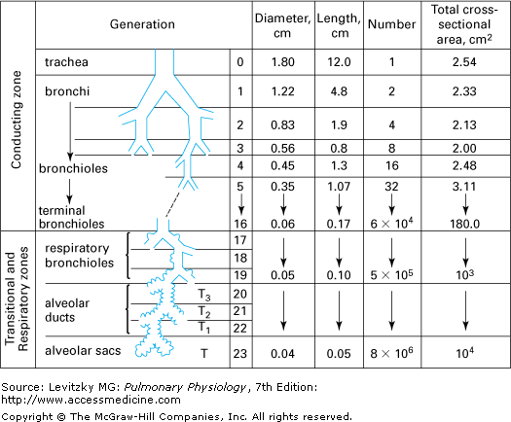
Diffusion of a Gas
Net movement of the molecules of a gas from a region of higher concentration to a region of lower concentration.
Net movement of the molecules of a gas from a region in which it exerts a higher partial pressure to an area in which it exerts a lower partial pressure.
Linear Velocity = Flow / Cross sectional Area
(cm/sec)
(cm³/sec)
(cm²)

Slide 21
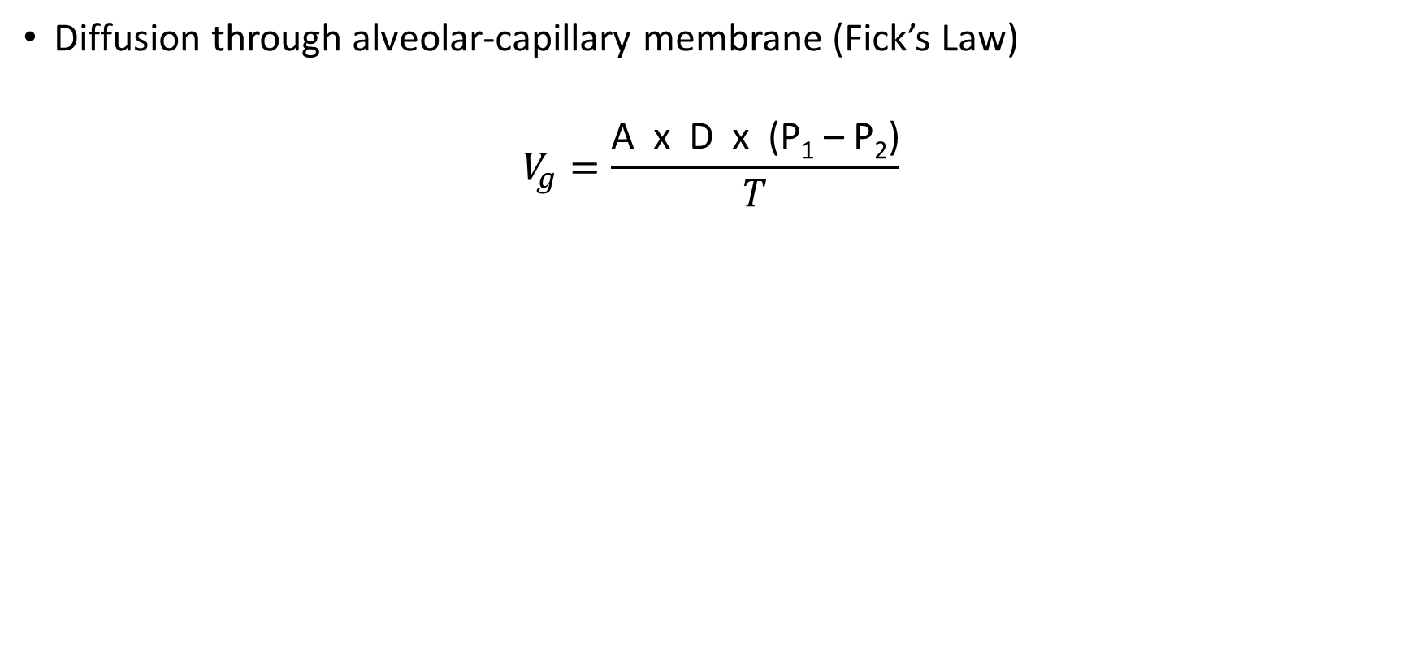
Fick’s law
V_{gas} = volume of gas diffusing through the tissue barrier per time (ml/min)
A = surface area available for diffusion (70 m² in a healthy adult)
D = diffusion coefficient, or diffusivity, of the particular gas
P₁ – P₂ = partial pressure difference of the gas across the barrier
T = thickness of the barrier or the diffusion distance (0.2 to 0.5 μm)

